Slide 1

Designing Accurate Agentic Workflows
Ability to Design Accurate SDLC Agentic Workflows

Slide 2
Today’s agenda
Setting up Context for AI Architecture
1
Setting up Router agent
2
Designing/Utilizing Custom MCP
3
Sample SDLC AI Driven Workflows
4

Slide 3
Setting up Context for AI Architecture
Notes:
As our market and customer needs continue to rapidly evolve, we’ve embraced change, identified opportunities, and have made headway to become a more competitive and agile company.
Our company’s Transformation supports our strategy as we streamline, modernize and invest so we can always operate from a position of strength.
We’ve identified six mega trends that we believe will have the biggest impact on our business. Each of those megatrends creates both opportunities, but as well challenges for us in the future…

Slide 4
Key Points to Remember
Design the Context Engineering around LLM Architecture and capability tier, not around a single model.
Setup a Base Dictionary knowledge.json file which acts as an index for repository.
Test the Context Engineered Platform both by using Positive and Negative Scenarios, Expected Result should be consistent business outcomes.
Context Engineering helps in grounding the AI to respond based on inhouse context which forms the core for Accurate Agentic Workflows

Slide 5
Setting up Router agent
Notes:
As our market and customer needs continue to rapidly evolve, we’ve embraced change, identified opportunities, and have made headway to become a more competitive and agile company.
Our company’s Transformation supports our strategy as we streamline, modernize and invest so we can always operate from a position of strength.
We’ve identified six mega trends that we believe will have the biggest impact on our business. Each of those megatrends creates both opportunities, but as well challenges for us in the future…

Slide 6
Key Points to Remember
Router Agent is a central agent which acts as a medium between user and multiple child agents.
Design Router agent with code base prompt design to call sub agent based on user’s input
Router agent is important step in agentic workflow as it enables controlled routing and governance layer before invoking LLMs.
Routing agent is important component to improve accuracy and reduce cost for Agentic Workflows

Slide 7
Designing Custom MCP
Notes:
As our market and customer needs continue to rapidly evolve, we’ve embraced change, identified opportunities, and have made headway to become a more competitive and agile company.
Our company’s Transformation supports our strategy as we streamline, modernize and invest so we can always operate from a position of strength.
We’ve identified six mega trends that we believe will have the biggest impact on our business. Each of those megatrends creates both opportunities, but as well challenges for us in the future…

Slide 8
Key Points to Remember
Leverage MCP to perform GET and POST Operation in addition to just acting as Knowledge source
Register tool inside MCP with unique name which can be implemented inside router agent which selects the tool to perform specific agentic operation.
Implement MCP to return TOON output during Decision Step and JSON output during Inference Step for LLM.
LLM decides which tool to invoke with help of router agent while MCP executes the bounded operation through exposed tools

Slide 9

Thought Process
When Designing the Agentic workflow , Identify which is AI component first rather than considering entire Workflow as AI.
Setup the Base Architecture of entire agentic workflow by leveraging the engineered context and how to route the user's input
Leverage LLMs only to decide or plan; while MCP, APIs or executors perform bounded actions.
Test the Workflows across multiple models to have an idea on how each model is interpreting the context and router agent
Test the entire workflow to validate the consistency

Slide 10
Benefits
Reduces Context Usage by approximately : 45%.
Improves Decision making ability of LLM
Improves Latency by at least 50%.
Enhanced Accurate output.
Enables Dependent on AI but Independent of AI toolset
A Copilot Power user member in Team used to exhaust Copilot Credits in 10 Days, but by employing this approach his credit usage stands at mere 27% at end of a month

Slide 11
Defect Creator Agent
Notes:
As our market and customer needs continue to rapidly evolve, we’ve embraced change, identified opportunities, and have made headway to become a more competitive and agile company.
Our company’s Transformation supports our strategy as we streamline, modernize and invest so we can always operate from a position of strength.
We’ve identified six mega trends that we believe will have the biggest impact on our business. Each of those megatrends creates both opportunities, but as well challenges for us in the future…

Slide 12
Use Case1
Goal of Defect Creator here is to Analyze a Test Failures and if any of those are Application under Test related issues , then create a Defect in Azure Devops board automatically.
For Example: Failures can be related to regular Automation Maintenance, these should be ignored.

Slide 13
Approach
Architecture Pseudocode :
Understand Test Failures and based on content of Logs filter failures which are due to Application , for example : 5xx error code can be due to application under test failure and store them in list “defects”.
Based on each “defects” list create defect for those in Azure Board.
Analyzing AI Work:
Here AI work is understand the root cause of error and classify them as Application issue or Maintenance Issue.
Solution:
Design “create_defects” API in MCP which can call the Azure Devops to create Defects based on content provided
Design Router agent to parse the test failures content
Design Custom Prompt for LLM analyze each test case failure and return only application failure list.
Design Router agent to call “create_defects” to create those defects returned by LLM

Slide 14
Story Creator Agent
Notes:
As our market and customer needs continue to rapidly evolve, we’ve embraced change, identified opportunities, and have made headway to become a more competitive and agile company.
Our company’s Transformation supports our strategy as we streamline, modernize and invest so we can always operate from a position of strength.
We’ve identified six mega trends that we believe will have the biggest impact on our business. Each of those megatrends creates both opportunities, but as well challenges for us in the future…

Slide 15
Use Case2
Goal of Story Creator Agent here is to Analyze large group of Development Team Stories and identify which Stories requires QA work and clone those stories in QA board.
For Example : Developer Stories might have work related to API keys update which doesn’t require QA activity, these stories should be filtered

Slide 16
Approach
Architecture Pseudocode :
Get all the Developer Stories in a list containing Title and Description of Stories and store it in Base list “Stories”.
If Title or Description of Stories contains text in dictionary filter list which contains {API keys, Jenkins Job, Python libraries etc.,} remove those stories from list “Stories”.
Create all Stories within the list “Stories” in Destination QA Board.
Analyzing AI Work:
Here AI work is to understand the Title and Description of Stories and remove stories which has mentioned keywords, as stories and description is language based , this is AI component to predict Semantics for the entire operation.
Solution:
Design “get_stories” API which can call the Azure Devops to get all stories in TOON Format. Design “create_stories” API which can create stories I Azure Devops
Design Router agent to call “get_stories” from custom MCP to return the list of all stories in TOON format.
Design Custom Prompt for LLM to get the list and remove the stories from the list containing dictionary keywords and return final stories list.
Design the Router agent to call “create_stories” from Custom MCP to create all the stories from final stories list.

Slide 17
Peer Review Agent
Notes:
As our market and customer needs continue to rapidly evolve, we’ve embraced change, identified opportunities, and have made headway to become a more competitive and agile company.
Our company’s Transformation supports our strategy as we streamline, modernize and invest so we can always operate from a position of strength.
We’ve identified six mega trends that we believe will have the biggest impact on our business. Each of those megatrends creates both opportunities, but as well challenges for us in the future…

Slide 18
Use Case3
Goal of Peer Review Agent here is to Analyze a Pull Request and suggest Recommendation back to User for improvement.
For Example: Developer might have created new method instead of reusing existing method which already exists

Slide 19
Approach
Architecture Pseudocode :
Understand the Requirement for which development work is done and get all the development components.
Based on each developed components create a base development code which aligns with standards and best practices of the framework.
Compare the base development code with actual developed code and provide recommendations if any.
Analyzing AI Work:
Here AI work is developing base development code aligning with best practices and compare that against developed code to suggest recommendations
Solution:
Design “get_pr_content” API which can call the Azure Devops to PR content and Design “get_stories_content” to get the Requirement from Azure Devops. Design “add_comment” API add comment to that PR.
Design Router agent to call “get_pr_content” and “get_stories”content” and leverage context engineering to refer the right existing code snippets and best practices for those based on requirements
Design Custom Prompt for LLM to develop base code aligning with best practices and compare that with developed code to give review comments
Design the Router agent to call “add_comment” from Custom MCP to suggested comment to PR.

Slide 20
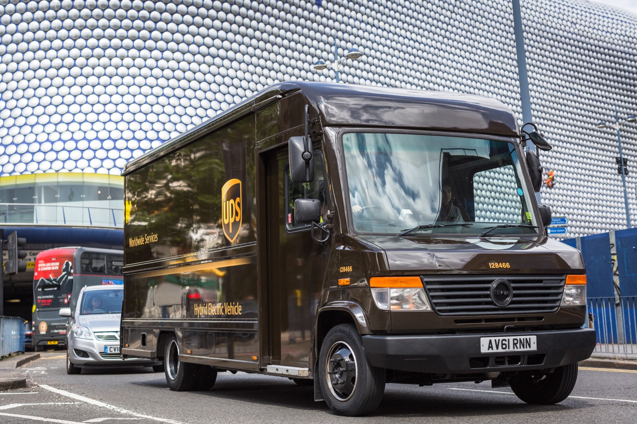
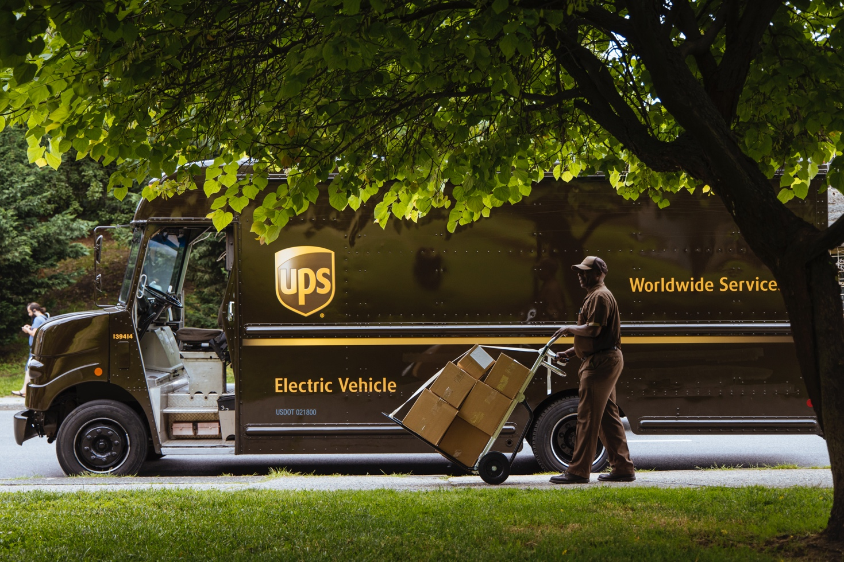
THANK YOU!

